Slide 1
SBHC NEWS
At the Harvest Center!
Notes:
You are now listening to the SBHC NEWS at the Harvest Center!

Slide 2
Cell Phones
We ask that you SILENCE your cell phone at this time. Thanks and enjoy the service.

Slide 3
Happy Birthday
Happy Birthday to all Partners and Visitors born in April.

Slide 4
The Theme for the Month of April
Prayer for Success and Prosperity, Joshua 1:8

Slide 5
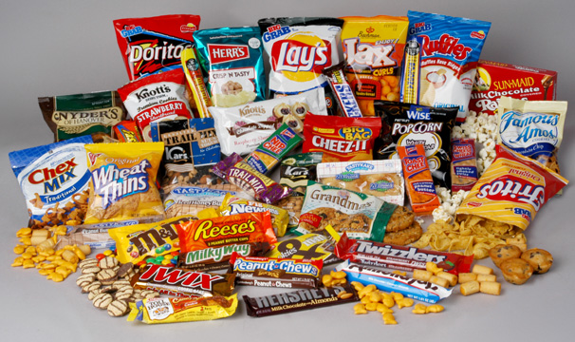
Message from the Pastor
Per Chief Apostle King, Please Do Not eat inside the Sanctuary! Please keep the church clean. DO NOT BRING FOOD INSIDE THE CHURCH or FOYER TO EAT. Parents also escort your child to the restroom! Thank You!

Slide 6
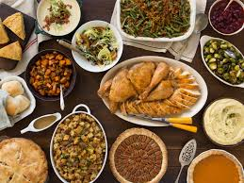
Bread Ministry
The Bread Ministry feeds the homeless every Thursday and help is needed. Please see Mother Thompson if you are interested.

Slide 7
You can pick up your photos from Easter Sunday in the Multiplex or foyer today after 10 am service. Donation is $5.00 and will go toward the Youth Ministry.

Slide 8
Kingdom Seekers Children’s Church is now open for ages 3-11 on 1st, 2nd, and 3, Sunday’s only. Take your child or children over to the education class rooms before service. You must be 18 years old or older to sign kids in and out. For more information please see Sister Cicely or Sister Kim.

Slide 9
The Blowout Committee is selling Krispy Kreme Doughnut Vouchers for $8 each. Please see Alexis, Tanise, Emmisha or Gabi. Thank you in advance!

Slide 10
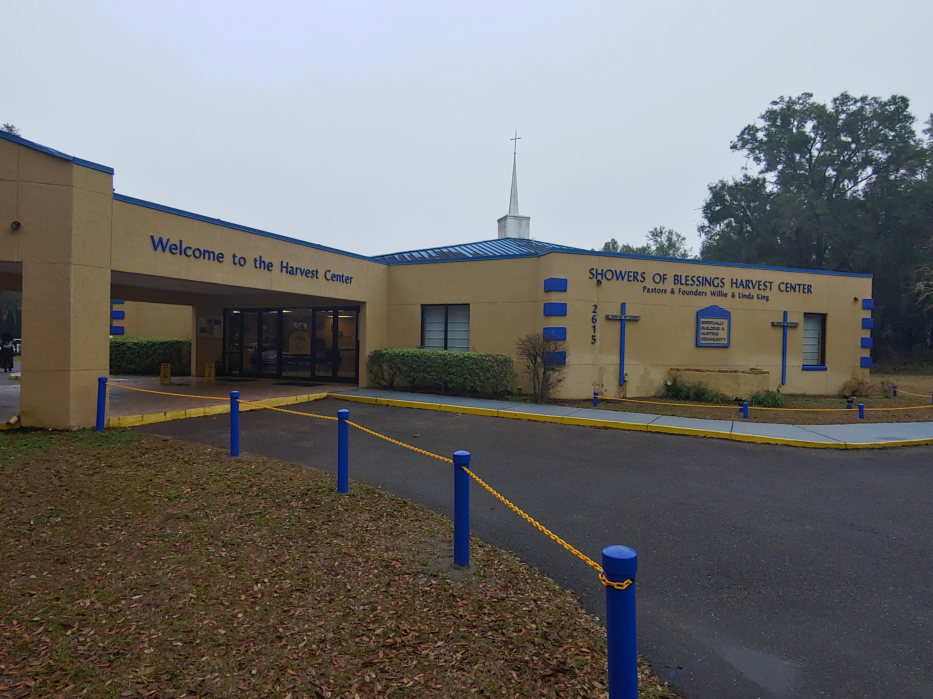
Partners In Covenant
Chief Apostle King has officially launched the “Partners In Covenant” program to pay-off the Church in two years. Each Leader and Partner is asked to give $25.00 dollars a week for two years towards paying off the church. Information on how you can participate and pay your vow is on the table in the foyer. Please complete your vow card and turn it in to Apostle King.

Slide 11
Pushpay
Showers Get Ready for the launching of our new website, the Showers Mobile App and the new Push Pay Giving App today during our 10 am service. Bring your iPad, mobile phones or laptops to connect to the new Showers Experience!

Slide 12
“WE ARE MORE THAN A CHURCH,” Leadership Workshop will be held on Saturday, May 11th from 9:30 am to 12 noon. Lunch will be served. This is mandatory for all Leaders! To be excused, YOU must see Apostle King.

Slide 13
Heaven’s Family Kitchen
from the Heart
will be selling dinners on May 12th after 10 am service. The menu includes Sliced Honey Ham, Meatballs w/Gravy and Smothered Pork Chops. There is also an Ox Tail Bowl with Rice Dinner. She is doing a Mother’s Day Special $1 dollar off one dinner purchased. You can now cash app @ $noop87. For pre-orders, call 386-972-4716. Please support Sis. Jeanette Watson as she move forward in the things of God.
Notes:
Ask her to wave her hand.

Slide 14
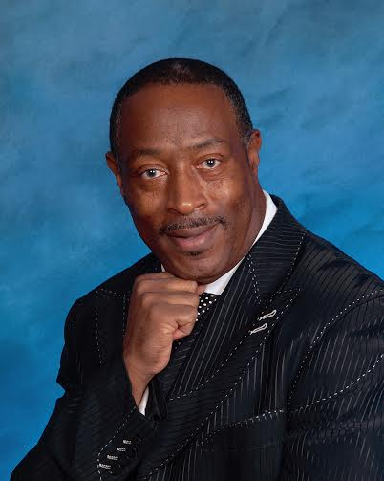
Possessing The Things of God
It’s “Revival Time” with Chief Apostle Willie L. King, Jr. Chief Apostle King will be in Revival here at Showers of Blessings Harvest Center Wednesday, May 15th – Friday, May 17th. Service will start at 7:30 pm nightly. Apostle King will delegate a ministry for each night. You don’t want to miss this Awesome move of God!

Slide 15
Chief Apostle King and Pastor Linda King wants to remind all Partners and Visitors that you can pay your tithes and offerings online using Push Pay. Visit our website at: www.showersofblessings.org. advance.

Slide 16
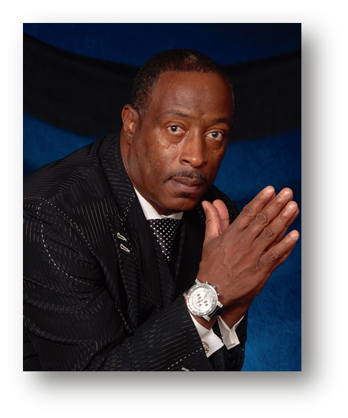
Church Consecration
Church fasting day is every Tuesday. There is no eating from 6am-6pm, after 6pm you may eat regularly. There is also a Command your morning conference call prayer every Tuesday at 5:30am. *Please mute your phones during prayer and please do not announce yourself*
The prayer line number has changed to
1-712-770-5565 and the Access Code is 723669#

Slide 17
Partners please visit our SBHC Bulletin Board located in the lobby for all other in house ministry announcements and the new Bulletin Board under the breezeway for the Pastors Engagements.
Bulletin Board
Notes:
Check here for all in house ministry announcements. Dance and Van.

Slide 18
JOIN US
Sunday’s:
10:00am Morning Glory Service
Tuesday’s: Noon Day Prayer
Wednesday’s: 7:30pm Hour of Power Bible Study
Notes:
Join us on Sunday’s at 8 am for our Fresh Manna Service and our 11 am Service. Tuesday’s noon day prayer. And Wednesday’s at 7:30 p.m. for our Hour of Power Bible Study.

Slide 19
We Welcome You!
Notes:
On behalf of Apostle Willie and Prophetess Linda King, we would like to welcome All of our visitors. Showers please welcome our visitors and each other to Showers of Blessings Harvest Center. The Church – “Where the Impossible – Is Possible.”

