Slide 1
PASTORS
ITINERARY
Notes:
You are now listening to the SBHC NEWS at the Harvest Center!

Slide 2
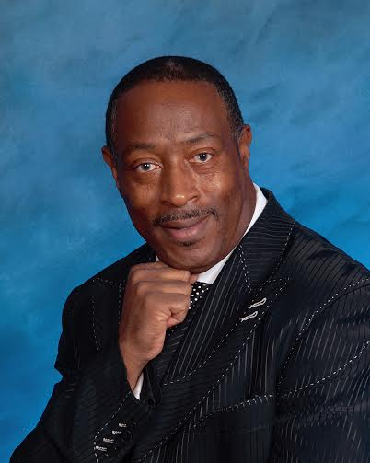
Possessing The Things of God
It’s “Revival Time” with Chief Apostle Willie L. King, Jr. Chief Apostle King will be in Revival here at Showers of Blessings Harvest Center Wednesday, May 15th – Friday, May 17th. Service will start at 7:30 pm nightly. Apostle King will delegate a ministry for each night. You don’t want to miss this Awesome move of God!

